Slide 1

WIPRO NGA Program – EP JAVA Batch
Capstone Project Presentation – 11TH July, 2024
Project Title – Wipro Wellness
Project Mentor – Md. Javeed
Team Lead – K Deepak
Team Member – Prajith Raj N, Harsh Kumar,
www.rpsconsulting.in

Slide 2

Objective
Healthcare management system, developed using Angular for the front-end and STS Spring for the back-end, is to create a secure, efficient, and user-friendly platform that enhances the delivery and management of healthcare services.
This system aims to streamline various administrative and clinical operations, improving the overall quality of care provided to patients while ensuring data security and privacy.
2024 - RPS Consulting all rights reserved

Slide 3
Project Overview
Wipro Wellness is a comprehensive healthcare management system designed to streamline patient management and enhance healthcare services.
The application aims to facilitate interactions between patients, doctors, and administrative staff, ensuring efficient appointment scheduling, medical record management, and secure communication.
2024 - RPS Consulting all rights reserved

Slide 4
Technologies Used
Frontend: Angular
Backend: Java, Spring Boot
Database: MySQL/ SQL Server
Authentication: JSON Web Tokens(JWT)
2024 - RPS Consulting all rights reserved

Slide 5
Project Scope
Efficient Appointment Booking: Patients can schedule appointments online, reducing waiting times.
Comprehensive Medical Records: Electronic storage and management of patient medical records.
Real-time Communication: Secure platform for communication between patients and doctors.
Administrative Automation: Simplifies administrative tasks like handling medical and staff records.
2024 - RPS Consulting all rights reserved

Slide 6
Problem Statement
Current healthcare facilities often face challenges in managing appointments, and communication between patients and healthcare providers.
Wipro Wellness addresses these issues by providing an integrated solution that improves operational efficiency and patient experience.
2024 - RPS Consulting all rights reserved

Slide 7
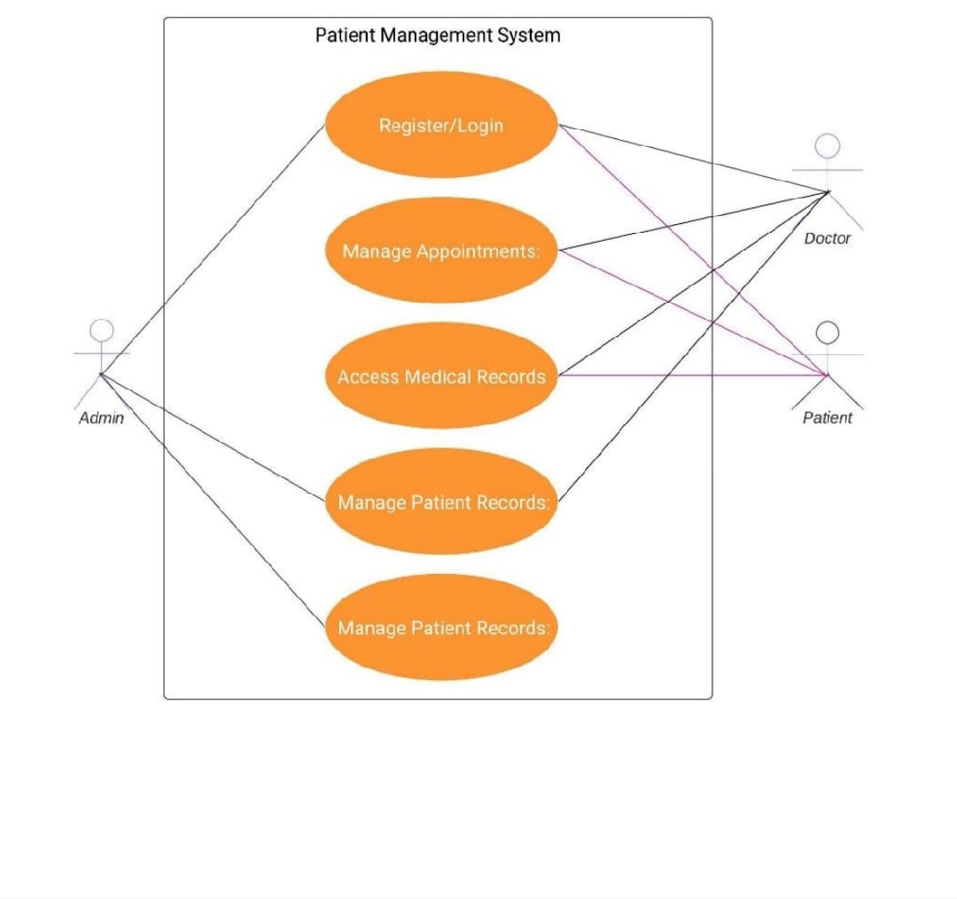
Use Case Diagram
2024 - RPS Consulting all rights reserved

Slide 8
What role patients have?
1.Register as a new patient
2. Log in as an existing patient
3. Update personal information
4. Schedule Appointment
5. View Medical History
6. View Appointments
7. Cancel Appointment
2024 - RPS Consulting all rights reserved

Slide 9
What role doctor have?
1. Log In as an existing Doctor
2. View Appointments
3. Patient authorization
4.Medical history
2024 - RPS Consulting all rights reserved

Slide 10
What role admin have?
Log In
Manage Appointments
Manage Doctors
4.Manage patients
2024 - RPS Consulting all rights reserved

Slide 11
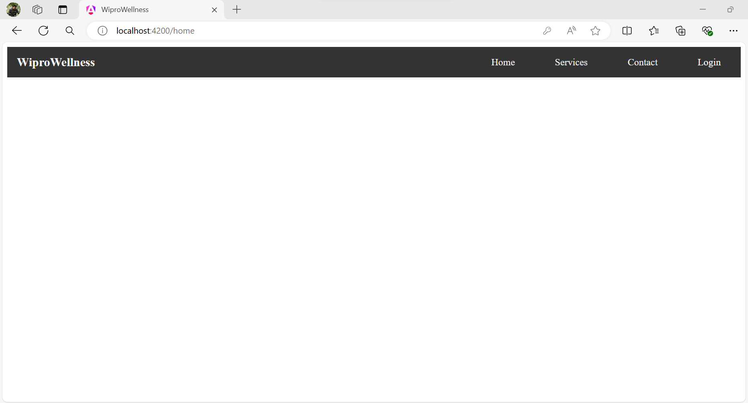
Here the Homepage of the Wipro WellNess project

Slide 12
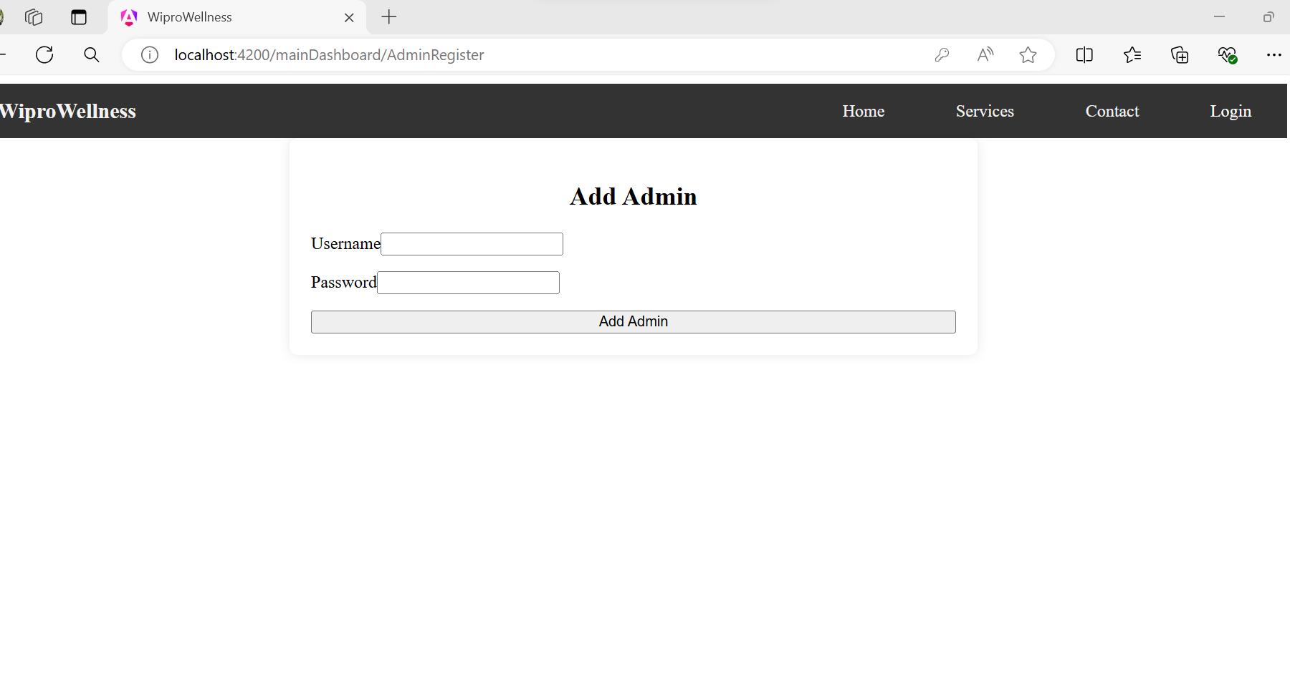
Registration of the Admin to access the Information in the WiproWellNess

Slide 13
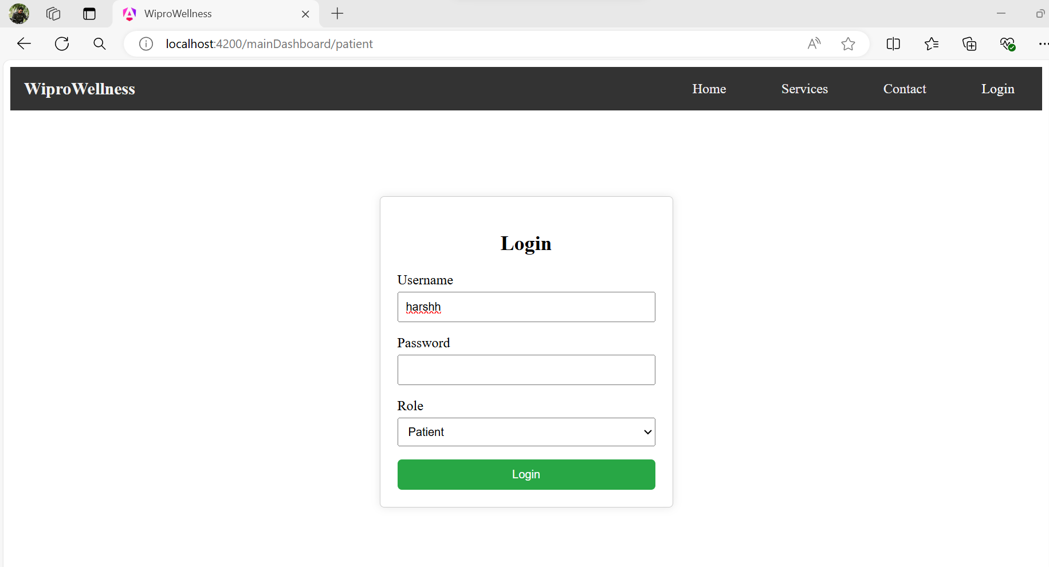
This is login dashboard page of login of patient

Slide 14
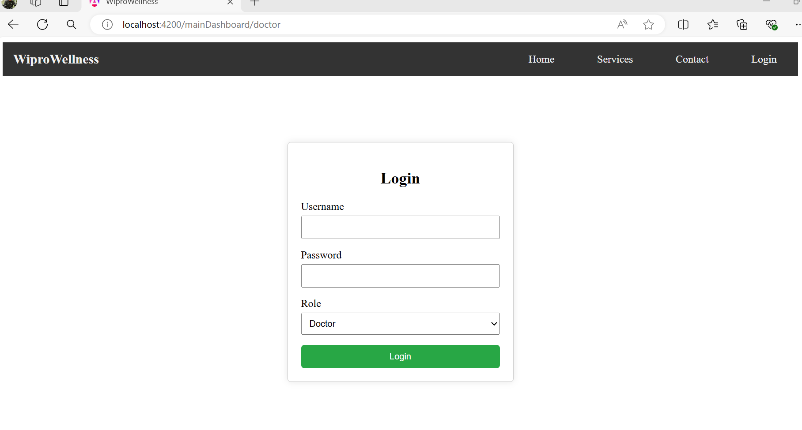
This is Doctor login dashboard

Slide 15
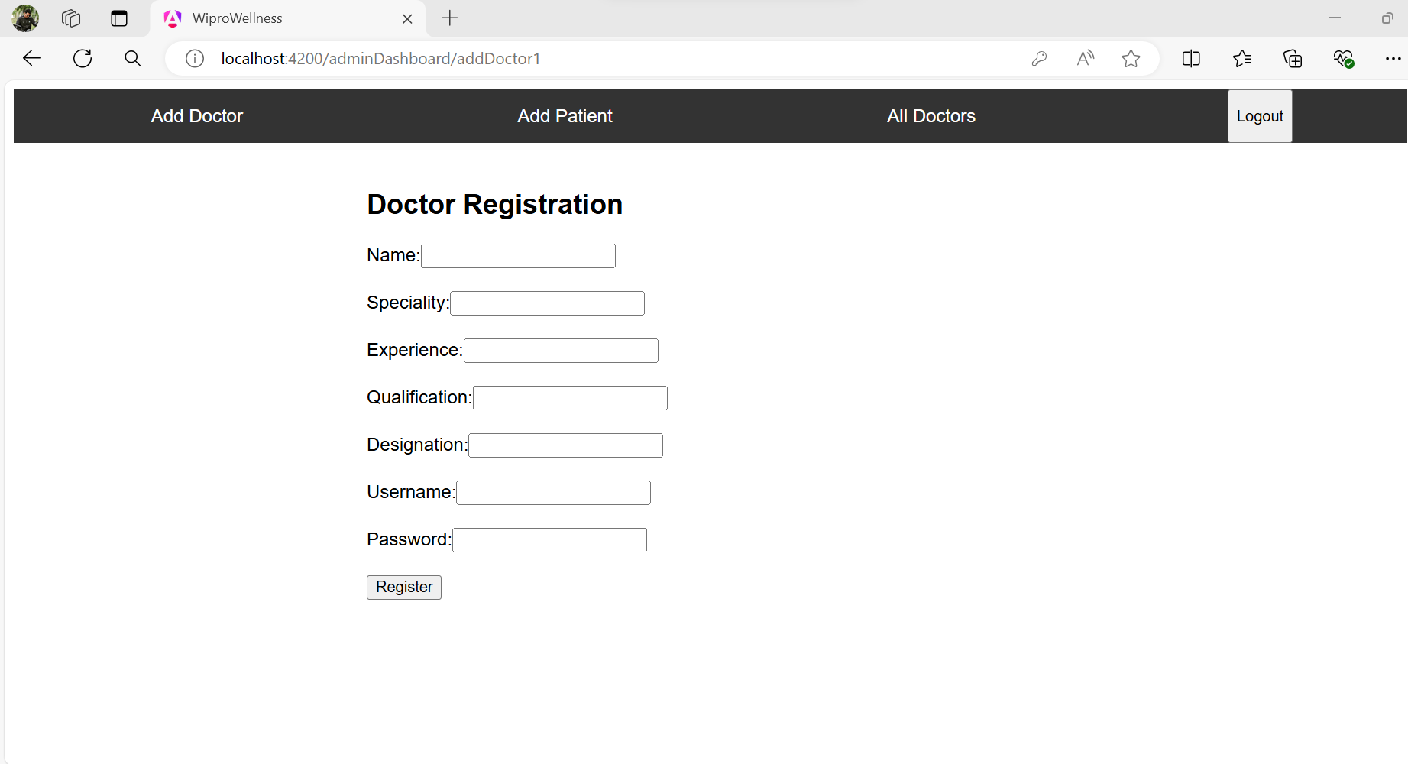
Here admin add the doctor in the portal and get the username

Slide 16
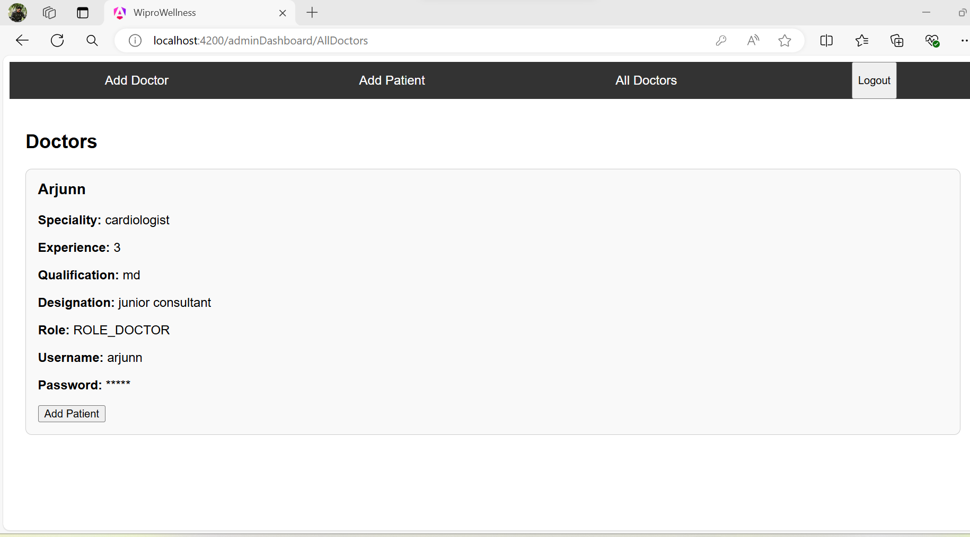
This is the alldoctors information and also the patient add here

Slide 17
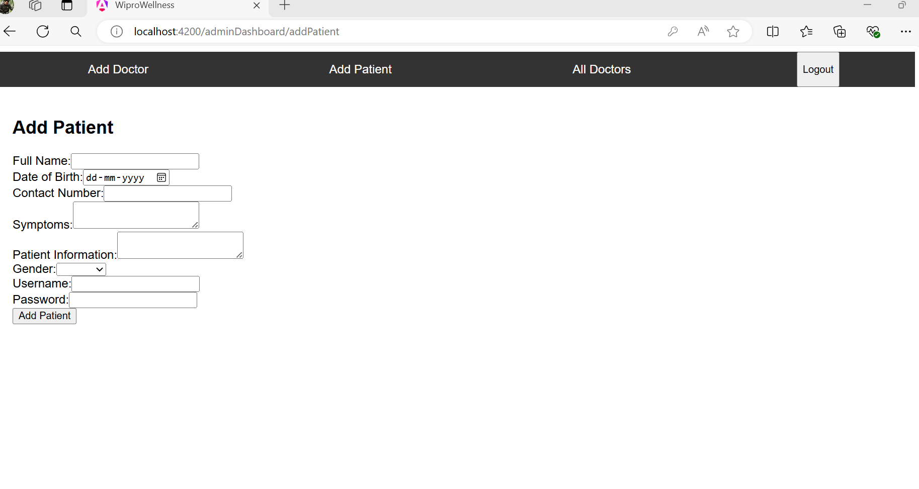
This is patient adding and getting access and username

Slide 18
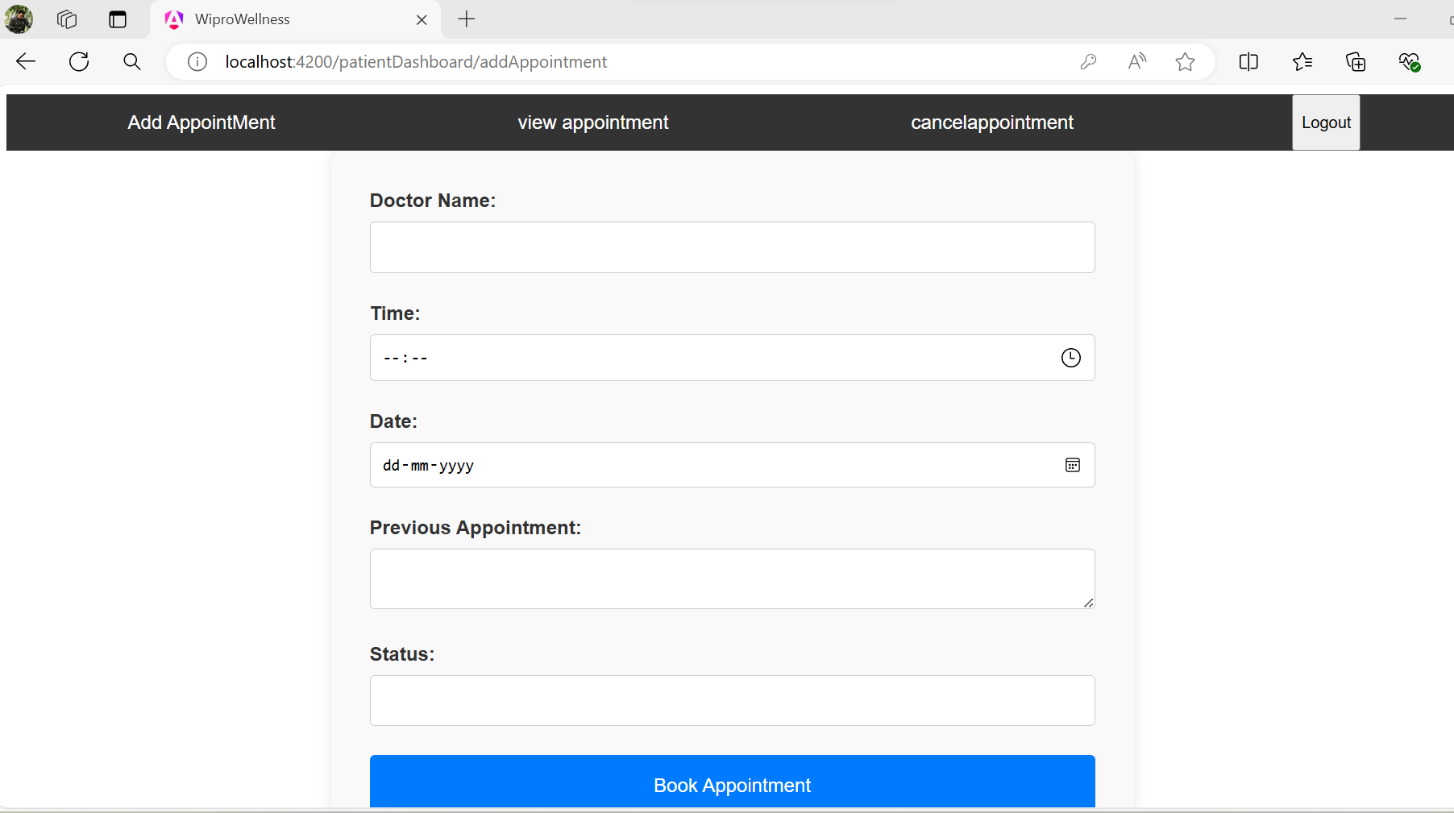
Here patient can Book the appointment and schedule

Slide 19
Conclusion
Wipro Wellness aims to transform hospital management by providing a seamless and efficient solution for patient management, appointment scheduling, and medical record handling.
The system's integration of modern technologies ensures a secure, scalable, and user-friendly platform for healthcare facilities.
2024 - RPS Consulting all rights reserved

Slide 20
Thank you!
2024 - RPS Consulting all rights reserved

